Slide 1
Acid/Base Titration
Purpose- to find the concentration of four HCl samples, by titrating them with 0.100M NaOH Solution(titrant).

Slide 2
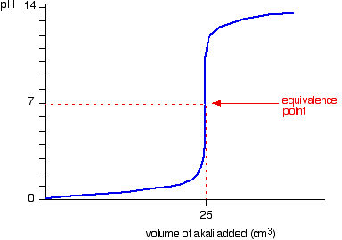
Titration Curve- graph of pH vs. volume of titrant added. Equivalence pt.- moles acid = moles base Indicator- a substance that changes color at a specific pH End Point-when the indicator changes colo.

Slide 3
Materials- buret, buret clamp, ring stand, funnel, 250 ml Erlenmeyer flask, large beaker, small beaker
Reagents-Unknown HCl samples, 0.100 M NaOH titrant, phenolphthalein indicator solution

Slide 4
Preparing the NaOH Titrant
Step1: Wash and rinse all glassware with soap, tap water, distilled
(or deionized) water.
Step2: Set up the buret in the buret clamp.
Step3: Flush the buret with two rinses of distilled water.
Step4: Using a small beaker and funnel, flush the buret w/ two rinses NaOH titrant solution.
Step5: Fill the buret with titrant.
Step6: Open the buret valve fully, until all air pockets are dispelled
from the tip of the buret.
Step7: Fill the buret with titrant between 0.00 mL and 1.00 mL. Remove funnel, Record this as “Initial Volume of Titrant”: in the data table.

Slide 5
Titrating Acid Sample
Step1: To a clean, dry erlenmeyer flask, add 10-15 mL of unknown acid sample, record the volume of acid to nearest 0.1 mL(V_{a}).
Step2: dilute the sample to 100 mL.
Step3: Add 1-2 drops of phenolphthalein indicator solution to the sample.
The sample is now ready to be titrated.
Step4: Titrate the sample until the endpoint of the titration is reached by the indicator change. Record the volume in the buret as “Final Volume of Titrant” in the data table.

